Slide 1
Banking Management System
Team members:
Bharadwaj
Deepali
Umang
Murari
Shankar
Biswajit

Slide 2
Table of contents
01
Introduction
02
System Architecture
03
Program Flow
04
ER Diagram
05
Functionalities
06
Reports and Analysis

Slide 3
Introduction
The Banking Management System (BMS) is a Python-based application designed to automate core banking activities such as account creation, deposits, withdrawals, fund transfers, and loan management.
The system uses MySQL database for secure data storage, ensuring real-time updates of account balances, transactions, customer profiles, and loan records.
It supports role-based access, where customers and administrators have separate login modules, enabling secure and controlled access to specific functionalities.
The project helps eliminate manual errors, improves efficiency of banking operations, and ensures accurate transaction history through automatic logging for transparency and record-keeping.

Slide 4
System Architecture
Admin / Customer
Input Credentials
Login and Authentication
Selects dashboard
(Customer or Admin)
Transaction History
Banking Functional Module
-- Account Management
-- Transaction (deposit/ withdraw/ transfer)
-- Loan: apply/ approve/ repay
-- Admin controls
-- Reports and Analysis
Database (MySQL)
Tables:
accounts, customers, loans, transactions, transfer_funds, admin, ifsc

Slide 5
Program Flow
Validate Credentials
No
Show error then go back to login
Start
Login window
Yes
Load dashboard based on role
End
Logout
Admin
Customer
Transaction History
Execute Selected Operations
Update Database table

Slide 6
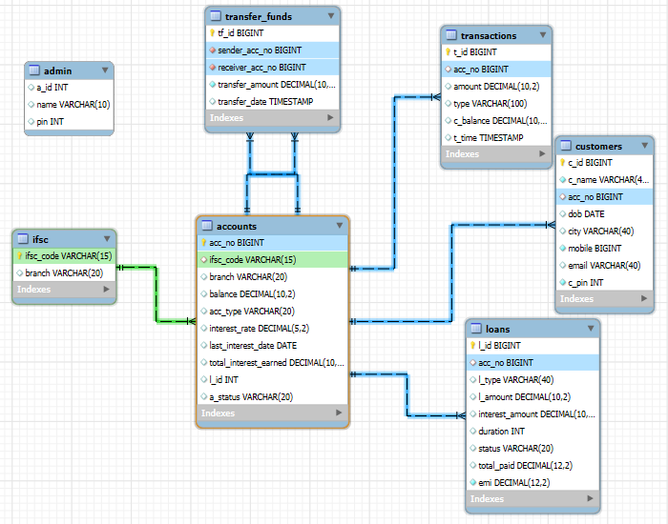
Database ER Diagram

Slide 7
Admin Functionalities
Admin Login: Secure access using Admin ID and PIN.
Manage Accounts: View, add, or delete customer accounts.
Approve / Reject Loans: Review loan applications and update loan status.
View Transactions: Monitor all customer transaction details.
Update Interest Rates: Modify rate of interest for loan schemes.
Generate Reports: View total deposits, loan summaries, and top customers.
System Monitoring: Track all operations for auditing and maintenance.

Slide 8
Customer Functionalities
Create Account: Register with personal and banking details.
Login: Secure access using mobile number and PIN.
Deposit Money: Add funds to the account and update balance.
Withdraw Money: Withdraw cash with sufficient balance check.
Transfer Funds: Send money to another account; updates both sender and receiver balances.
Check Balance: View current available balance anytime.
View Transactions: Displays detailed transaction history.
Apply for Loan: Submit loan request specifying type and amount.
Repay Loan: Make EMI or full repayment, updates loan and balance tables.
Forgot PIN: Option to reset forgotten PIN securely.

Slide 9
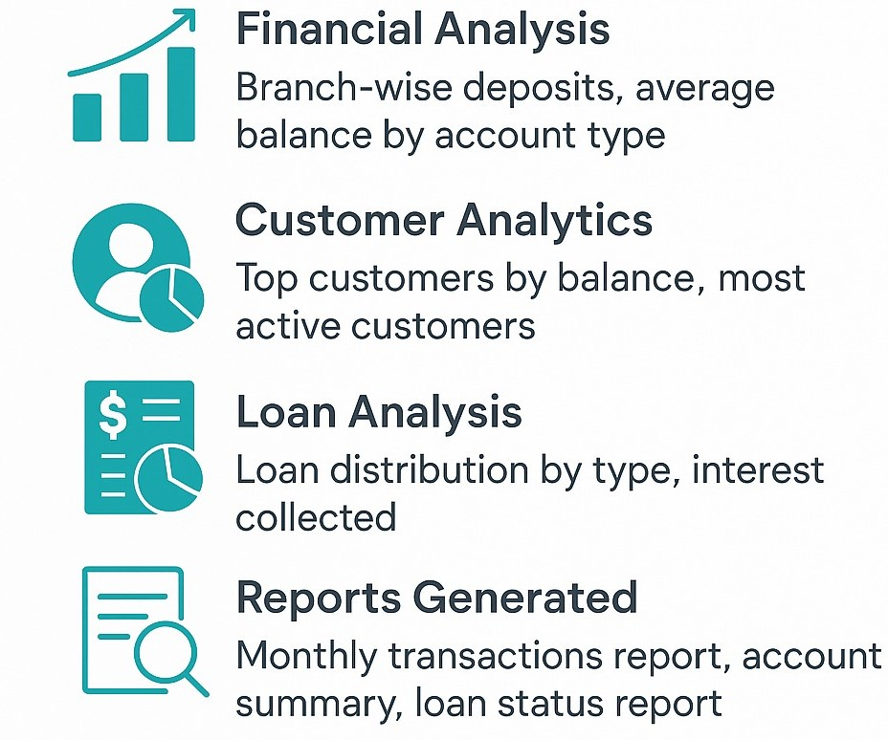
Reports and Analysis

Slide 10
Thank You

